Slide 1

Love Poem
Search Engine
By
Dennis Li
Sharon Yang
Fang Zheng
Brandon Zhang

Slide 2
Index
Title page
Index
Why we picked love poem
Our dataset
UML explained
Program walk-through
Live demo

Slide 3
Love poems
Love poems are a type of poem whose main purpose is to express love
We chose this topic as there are generally less words in a poem compared to a song making it easier to work to with

Slide 4

Data
We obtained our data from
https://interestingliterature.com/2016/08/10-very-short-love-poems-everyone-should-read/
https://classicalpoets.org/2016/10/27/10-greatest-love-poems-ever-written/
The fields we picked are
Title
Author
Year
Country
Poem

Slide 5
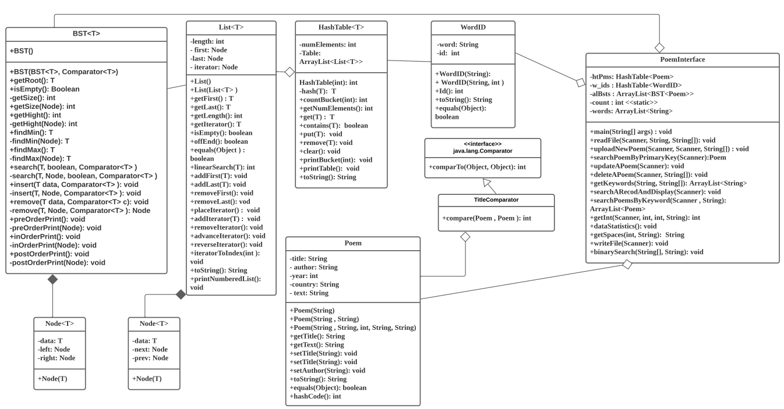
Overview of UML diagram

Slide 6
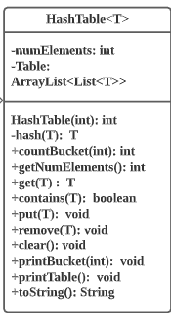
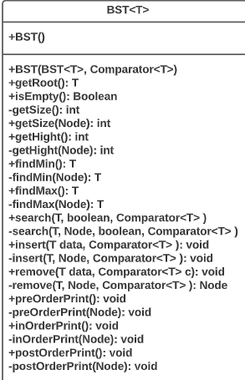
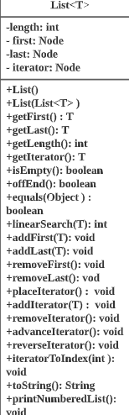
Brandon
The Binary Stack Tree is used to hold references to the poems in the index
The hashtable stores all the WordID classes which hold the index to the location of the Poems that have that keyword
The list is used to handle collisions within the hash table using separate chaining
Data Structures to explain:
HashTable
BST
List

Slide 7
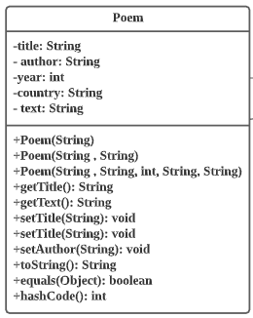
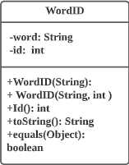
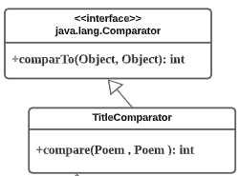
Dennis
The poem class holds the data for all of our poems and has a custom hashcode method
The WordID class holds the data for keyWords and their ID
The comparator is used to distinguish where the poem class should go in a BST
The comparator uses the title of said to poem to compare them
Classes to explain:
Poem
WordID
+hashCode(): int

Slide 8
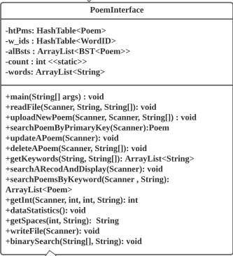
Sharon
Poem Interface is the main driver class of this entire program
It displays the menus and takes input to give functionality to the rest of the classes
Key method to explain:
uploadNewPoem()
searchPoemByPrimaryKey()
updateAPoem()
deleteAPoem()
dataStatistics()

Slide 9
Fang
Key method to explain:
searchPoemByKeyword()

Slide 10
Search engine
The search engine allows the user to search via keyword for entries in our system
For example, in our system, 9 poems contain the word “love” in their text, if user types “love”, the poems’ titles containing “love” will be displayed. By entering the number that corresponds to the title, we can see additional information.
The user also can search only one poem by entering primary key(Title and author) or enter title only.

Slide 11
Feedback
We chose 2 participants from our friends at random and gave them the following
3 scenarios
Search for an existing poem and read it’s contents
Add a poem and search for it
Look at statistics, remove a poem(poem that affects the stats), and look at statistics again.

Slide 12
Participant 1
Feedback
Overall Navigation is clear
All the functionality works if valid choices are given
For search functionality
The users have to know the author names or keywords in order to perform a search
Printing information such as Author name or keywords should be an option to show choices
When users enter an invalid choice
Java exception is thrown
The exception handling should be caught and allow the user to enter another choice

Slide 13

Participant 2
Feedback
The search title/author
Search is case sensitive which is not ideal
When search options are displayed typing title should be an option with typing in a title
The options should be author or title
Menu traversability
Typing x whenever should offer the option to go backwards in the menu
When displaying a poem the menu comes up right after disrupting the poem
Instead a line that says “press enter to continue” would be nice to not interrupt the flow
Instead of using numbers for the search options using letters would be more consistent
Uploading poems
The program should have it’s own txt file where poems are updated in real time

Slide 14
How we used the feedback
We handled the exceptions and gave the users another choice if they entered and invalid choice
The keyword is no longer case sensitive

Slide 15
Thank You for watching

Slide 16
Get all structures
Major structures
HashTable<Poem>
HashTable<WordID>
ArrayList<BST<Poem>
Other helpful structures
ArrayList<String> unique_keywords
Array<String> stopwords
.

Slide 17
Data Sample - Love Poems
Title + Author –> unique key
Year
Country of origin
Full Text of poem
Question: What techniques to build a search engine?

Slide 18
Inverted Index for Information Retrieval
Forward index: document(s) - > contents
Inverted index: contents -> document(s)
Question: How to use a content as an index of an array?
(Strings cannot be used as the indices of arrays in Java language.)

Slide 19
WordID Object
public class WordID {
private String word;
private int id;
public WordID(String word){
this.word = word;
this.id = 0; // static int index;
}
}
Question: How to map unique keyword to unique ID?
HashTable<WordID>
Next question:
What is the best data structure to use for an array of a set of LovePoem objects?

Slide 20
ArrayList<BST<LovePoem>>
ArrayList is a random access, variable-size list data structure that allows elements to be added or removed easily
BST provides an efficient insertion, deletion, and searching
The set of elements in BST is available in sorted order
Next question: Other major data structure applied?
HashTable<LovePoem>
HashTable provides an efficient searching to retrieve value using its hashed key.
Extension:
Create an interactive data processing system, with a menu of options provided to the user.

Slide 21
Next Step for Search Engine
Get close matches keyword
Fuzzy Search (wildcard characters)

